Slide 1

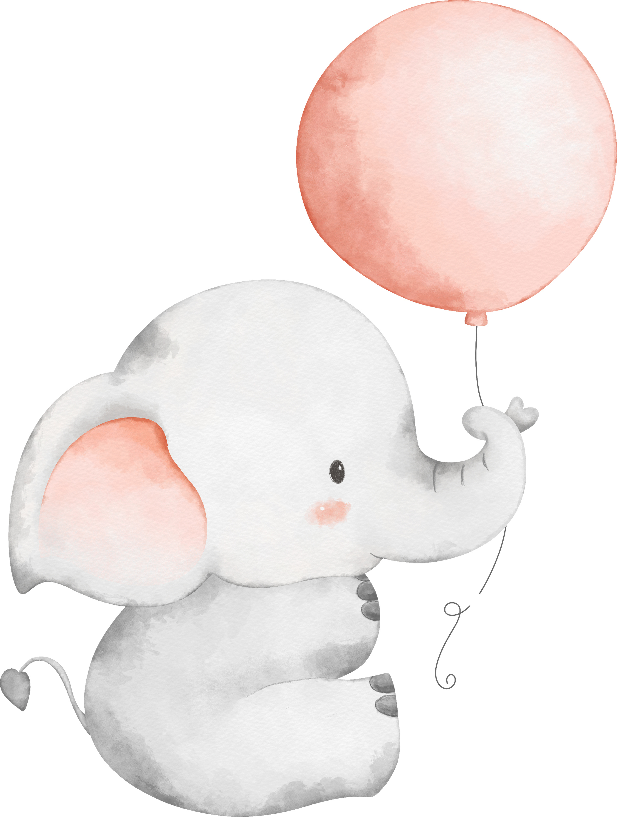




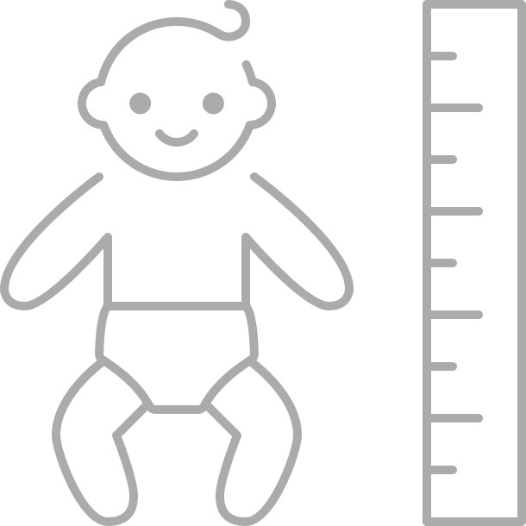
OLIVIA
8 JUNE 2026
6:30am | 3200g | 51cm

